Slide 1
SysEng 5211/ECE5310
Computational Intelligence
Steven Corns
Machine Learning

Slide 2
Machine Learning
Getting computers to learn without being explicitly told
Has a basis in probability and regression analysis

Slide 3
Machine Learning
Pattern recognition
Computational learning
System controls

Slide 4
Supervised Learning
Machine learning to determine a function describing the relationship between input and output when labeled data is provided
  Input vector matched to an output value (supervisory signal)
Predictive Models

Slide 5
Unsupervised Learning
Machine learning to determine a relationships between elements of the data with no labels or indication of what the underlying relationships may be.
  Typically used for clustering and associative reasoning
Descriptive models

Slide 6
Reinforcement Learning
Machine learning that determines the actions that agents should take within a given environment.
  Typically used for artificial life
  Applications include robot control, elevator scheduling, and telecommunications

Slide 7
Can be approached with
Neural Networks
Fuzzy Systems
Evolutionary Computation

Slide 8
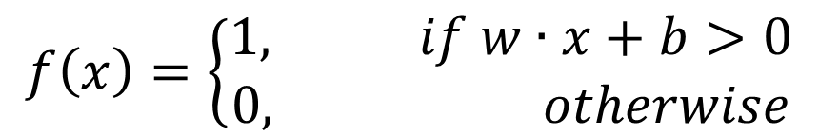
Example: NN
Using the data:
Using
$$\left\{p_{1}=\left[\begin{matrix}2 \\ 3\end{matrix}\right],t_{1}=1\right\},\left\{p_{2}=\left[\begin{matrix}−1 \\ 0\end{matrix}\right]{,t}_{2}=0\right\},\left\{p_{3}=\left[\begin{matrix}1 \\ 2\end{matrix}\right]{,t}_{k}=1\right\}$$
$$f\left(x\right)=\left\{\begin{matrix}1, if w∙x+b>0 \\ 0, otherwise\end{matrix}\right.$$

Slide 9
Example: NN
In this case, P is the input and t is the desired result
What is the learning associated with this?

Slide 10
Example: NN

Slide 11


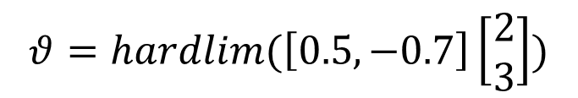
Example: NN
Let ₁w^{T}= {0.5,-0.7]:
$$θ=hardlim(\text{1}\text{w}\text{T})$$
$$θ=hardlim(\left[0.5,−0.7\right]\left[\begin{matrix}2 \\ 3\end{matrix}\right])$$
$$θ=hardlim\left(−1.1\right)=0$$

Slide 12
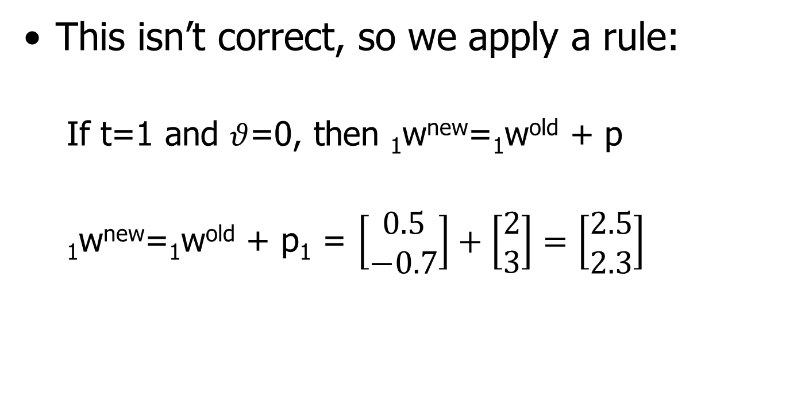
Example: NN
This isn’t correct, so we apply a rule:
  If t=1 and $θ$=0, then ₁w^{new}=₁w^{old} + p
  ₁w^{new}=₁w^{old} + p₁ = $\left[\begin{matrix}0.5 \\ −0.7\end{matrix}\right]+\left[\begin{matrix}2 \\ 3\end{matrix}\right]=\left[\begin{matrix}2.5 \\ 2.3\end{matrix}\right]$

Slide 13

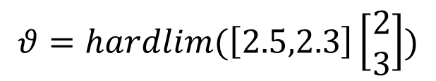
Example: NN
Now ₁w^{T}= {2.5,2.3]:
$$θ=hardlim(\text{1}\text{w}\text{T})$$
$$θ=hardlim(\left[2.5,2.3\right]\left[\begin{matrix}2 \\ 3\end{matrix}\right])$$
$$θ=hardlim\left(11.9\right)=1$$

Slide 14

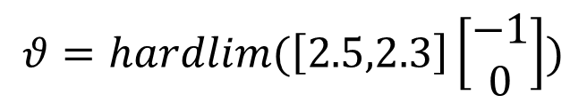
Example: NN
For the second input:
$$θ=hardlim(\text{1}\text{w}\text{T})$$
$$θ=hardlim(\left[2.5,2.3\right]\left[\begin{matrix}−1 \\ 0\end{matrix}\right])$$
$$θ=hardlim\left(−2.5\right)=0$$
OK

Slide 15
Example: NN
For this example, the input is adjusted based on the training data
  Will this continue to improve the weights?
  How else might we adjust the weights?
    Evolutionary computation creating a population of weights that could be trained

Slide 16





Example: NN XOR
What if the function we were representing was XOR?
$$x_{1}⊕x_{2}=y$$
$$0⊕0=0$$
$$1⊕0=1$$
$$0⊕1=1$$
$$1⊕1=0$$

Slide 17
Example: NN XOR

Slide 18
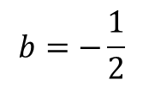
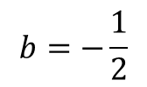
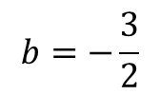
Example: NN XOR
$$b=−\frac{3}{2}$$
Using a threshold function*:
+1
X₁
$$b=−\frac{1}{2}$$
+1
-2
y
+1
+1
X₂
+1
$$b=−\frac{1}{2}$$
Input
Layer
Hidden
Layer
Output
Layer
*McCulloch-Pitts Model

Slide 19
Example: NN XOR

Slide 20
Example: Evolutionary Computation XOR
EC XOR can be performed using:
  Representation involving two or more operators, which can be done using Genetic Programming

Slide 21
Example: Evolutionary Computation XOR
EC XOR using GP
Leaf is variable or constant
Nodes are operators

Slide 22
Example: Genetic Programming XOR
%
2
+
x₁
x₂

Slide 23
Example: Evolutionary Computation XOR
What is the fitness landscape to find this solution?
What alphabets are used?
Can it be found using an exhaustive search?

Slide 24
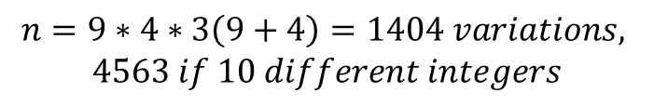
Example: Evolutionary Computation XOR
Operator nodes: (+,-,*,/,^,log,ln,!,%,etc.)
Leaf nodes (variables,integers,reals, etc.)
With these examples:
  9 operators, two variables, five nodes (one has to be an operator and one has to be a leaf)
$$n=9∗4∗3\left(9+4\right)=1404 variations,$$
$$4563 if 10 different integers$$

Slide 25
Example: Genetic Programming XOR crossover

Slide 26
Example: Genetic Programming XOR crossover

Slide 27
Problem representation
Problem representation impacts how well our machine learning algorithm can ‘learn’.
Typically problem dependent

Slide 28
Data Sets
All machine learning requires data
  Training set
  Testing set
Where do you get data?
What does it look like?

Slide 29
Data Sets
Several repositories exist:
  University of California Irvine http://archive.ics.uci.edu/ml/
  Golem -http://www.cs.ox.ac.uk/activities/machinelearning/applications.html
  Delve - http://www.cs.toronto.edu/~delve/data/datasets.html

Slide 30
Abolone data set
M 0.455 0.365 0.095 0.514 0.2245 0.101 0.15 15
M 0.35 0.265 0.09 0.2255 0.0995 0.0485 0.07 7
F 0.53 0.42 0.135 0.677 0.2565 0.1415 0.21 9
M 0.44 0.365 0.125 0.516 0.2155 0.114 0.155 10
I 0.33 0.255 0.08 0.205 0.0895 0.0395 0.055 7
I 0.425 0.3 0.095 0.3515 0.141 0.0775 0.12 8
F 0.53 0.415 0.15 0.7775 0.237 0.1415 0.33 20
F 0.545 0.425 0.125 0.768 0.294 0.1495 0.26 16
M 0.475 0.37 0.125 0.5095 0.2165 0.1125 0.165 9
F 0.55 0.44 0.15 0.8945 0.3145 0.151 0.32 19
F 0.525 0.38 0.14 0.6065 0.194 0.1475 0.21 14
M 0.43 0.35 0.11 0.406 0.1675 0.081 0.135 10
M 0.49 0.38 0.135 0.5415 0.2175 0.095 0.19 11
Accessed through Delve

Slide 31
Abolone data set
Attributes (9)
M 0.455 0.365 0.095 0.514 0.2245 0.101 0.15 15
Desired
Result
This data set has 4177 cases (vectors)

Slide 32
Abolone data set
Predicting the age of abalone from physical measurements.
Name Data Type Meas. Description
---- --------- ----- -----------
Sex nominal M, F, and I (infant)
Length continuous mm Longest shell measurement
Diameter continuous mm perpendicular to length
Height continuous mm with meat in shell
Whole weight continuous grams whole abalone
Shucked weight continuous grams weight of meat
Viscera weight continuous grams gut weight (after bleeding)
Shell weight continuous grams after being dried
Rings integer +1.5 gives the age in years

Slide 33
Sam Waugh (1995) "Extending and benchmarking Cascade-Correlation"
PhD thesis, Computer Science Department, University of Tasmania.
-- Test set performance (final 1044 examples, first 3133 used for training):
24.86% Cascade-Correlation (no hidden nodes)
26.25% Cascade-Correlation (5 hidden nodes)
21.5% C4.5
0.0% Linear Discriminate Analysis
3.57% k=5 Nearest Neighbour
(Problem encoded as a classification task)
Cascade-Correlation is a modification of a neural network:
http://www.ra.cs.uni-tuebingen.de/SNNS/UserManual/node164.html

Slide 34
David Clark, Zoltan Schreter, Anthony Adams "A Quantitative Comparison of
Dystal and Backpropagation"
Data set treated as a 3-category classification problem (grouping ring classes 1-8, 9 and 10, and 11 on).
submitted to the Australian Conference on
Neural Networks (ACNN'96)

Slide 35
David Clark, Zoltan Schreter, Anthony Adams "A Quantitative Comparison of
Dystal and Backpropagation"
Test set performance (3133 training, 1044 testing as above):
64% Backprop
55% Dystal
-- Previous work (Waugh, 1995) on same data set:
61.40% Cascade-Correlation (no hidden nodes)
65.61% Cascade-Correlation (5 hidden nodes)
59.2% C4.5
32.57% Linear Discriminate Analysis
62.46% k=5 Nearest Neighbour

Slide 36
Fuzzy System
What rules could we make?
What would be the membership functions?

Slide 37
Shell Length
Need to Normalize!

Slide 38
Abolone Fuzzy Relations
Suppose Shell Length={Short(S), Medium(M), Long(L)}, Shucked Weight={Low(L), Medium(M), High(H)},
  If Shell length =SHORT= 1.0/S+0.5/M+0.0/L and Shucked Weight = MEDIUM = 0.2/L+1.0/M+0.1/H
  We can examine a rule: If Shell Length is SHORT and Shucked Weight is MEDIUM then age is MORE_OR_LESS_YOUNG

Slide 39
Abolone Fuzzy Relations
Suppose Shell Length={Short(S), Medium(M), Long(L)}, Shucked Weight={Low(L), Medium(M), High(H)},
  If Shell length =SHORT= 1.0/S+0.5/M+0.0/L and Shucked Weight = MEDIUM = 0.2/L+1.0/M+0.1/H
  We can examine a rule: If Shell Length is SHORT and Shucked Weight is MEDIUM then age is MORE_OR_LESS_YOUNG

Slide 40
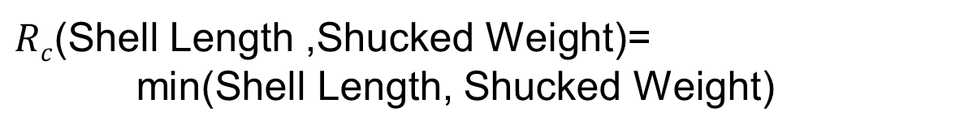
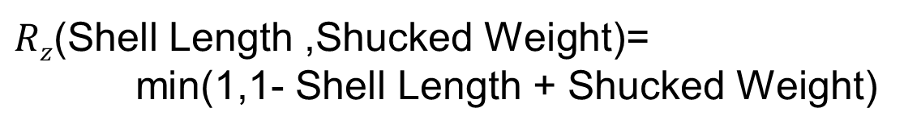
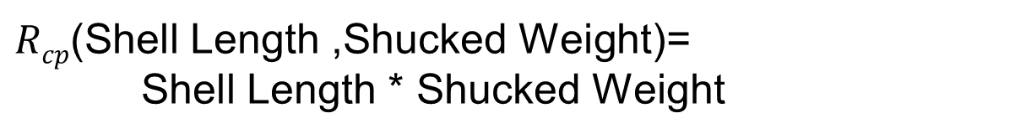
We can use our Fuzzy Relations…
$Rz$(Shell Length ,Shucked Weight)=
min(1,1- Shell Length + Shucked Weight)
$Rc$(Shell Length ,Shucked Weight)=
min(Shell Length, Shucked Weight)
$Rcp$(Shell Length ,Shucked Weight)=
Shell Length * Shucked Weight

Slide 41



Fuzzy Relations
This can be done for all of the values to visualize the results
R_{z} = $\left(\begin{matrix}1.0 \\ 0.5 \\ 0.0\end{matrix}\right)∙\left(\begin{matrix}0.2 & 1.0 & 0.1\end{matrix}\right)=\left(\begin{matrix}0.2 & 1.0 & 0.1 \\ 0.7 & 1.0 & 0.6 \\ 1.0 & 1.0 & 1.0\end{matrix}\right)$
R_{cm} = $\left(\begin{matrix}1.0 \\ 0.5 \\ 0.0\end{matrix}\right)∙\left(\begin{matrix}0.2 & 1.0 & 0.1\end{matrix}\right)=\left(\begin{matrix}0.2 & 1.0 & 0.1 \\ 0.2 & 0.5 & 0.1 \\ 0.0 & 0.0 & 0.0\end{matrix}\right)$
R_{cp} = $\left(\begin{matrix}1.0 \\ 0.5 \\ 0.0\end{matrix}\right)∙\left(\begin{matrix}0.2 & 1.0 & 0.1\end{matrix}\right)=\left(\begin{matrix}0.2 & 1.0 & 0.1 \\ 0.1 & 0.5 & 0.05 \\ 0.0 & 0.0 & 0.0\end{matrix}\right)$

Slide 42



Applying our rule
For a short shell (1.0,0.5,0.0)
Age_{z} = $\left(\begin{matrix}1.0 & 0.5 & 0.0\end{matrix}\right)∘\left(\begin{matrix}0.2 & 1.0 & 0.1 \\ 0.7 & 1.0 & 0.6 \\ 1.0 & 1.0 & 1.0\end{matrix}\right)=(0.7 1.0 0.6)$
Age_{cm} = $\left(\begin{matrix}1.0 & 0.5 & 0.0\end{matrix}\right)∘\left(\begin{matrix}0.2 & 1.0 & 0.1 \\ 0.2 & 0.5 & 0.1 \\ 0.0 & 0.0 & 0.0\end{matrix}\right)$=(0.2 1.0 0.1)
Age_{cp} = $\left(\begin{matrix}1.0 & 0.5 & 0.0\end{matrix}\right)∘\left(\begin{matrix}0.2 & 1.0 & 0.1 \\ 0.1 & 0.5 & 0.05 \\ 0.0 & 0.0 & 0.0\end{matrix}\right)=(0.2 1.0 0.1)$

Slide 43



What if Shell Length was Long?
(0.0,0.0,1.0)
Age_{z} = $\left(\begin{matrix}0.0 & 0.0 & 1.0\end{matrix}\right)∘\left(\begin{matrix}0.2 & 1.0 & 0.1 \\ 0.7 & 1.0 & 0.6 \\ 1.0 & 1.0 & 1.0\end{matrix}\right)=(1.0 1.0 1.0)$
Age_{cm} = $\left(\begin{matrix}0.0 & 0.0 & 1.0\end{matrix}\right)∘\left(\begin{matrix}0.2 & 1.0 & 0.1 \\ 0.2 & 0.5 & 0.1 \\ 0.0 & 0.0 & 0.0\end{matrix}\right)$=(0.0 0.0 0.1)
Age_{cp} = $\left(\begin{matrix}0.0 & 0.0 & 1.0\end{matrix}\right)∘\left(\begin{matrix}0.2 & 1.0 & 0.1 \\ 0.1 & 0.5 & 0.05 \\ 0.0 & 0.0 & 0.0\end{matrix}\right)=(0.0 0.0 0.05)$

Slide 44
Evolutionary Computation
0
1
2
3

Slide 45
Evolved List
Start at 0
0 If shell length > 0.4 then (age=age+1; goto 3)
If shell length ≤ 0.4 then (age=age; goto 2)
If Shucked Weight < 0.5 (age=age-1; goto 0)
If Shucked Weight > 0.7 (age=age+1; goto 2)
Else (goto 3)
2 …

Slide 46
Machine Learning
Many methods, choice depends on data format

Slide 47
Moving Forward
Next week:
  Research Paper Examples/more machine learning
  Proposal due

Slide 48
Program Completed
Missouri University of Science & Technology
© 2003 Curators of University of Missouri

